Slide 1
Neuron Tracker Demo
Matt Tso
1/28/2016
Herzog Lab Meeting

Slide 2
Disclaimer
extract_data.py is written by Ben Bales from Petzold Lab (UCSB)
extract_data_supp.py, CCD_divide2.m r_circular_example.r are written by Matt Tso
Chronostar is written by Stephan Lovenzen, Institute of Theoretical Biology, Humbold-University, Berlin, Germany
Circular is a publicly available R package

Slide 3
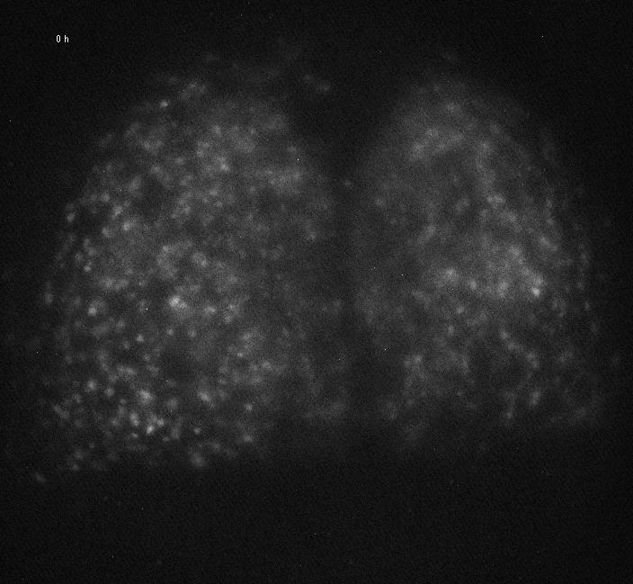
Sample Data: Per2::luc SCN Post-TTX from Daniel

Slide 4
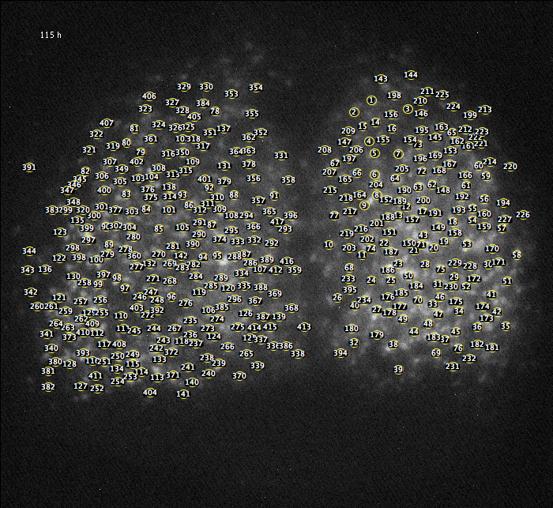
Motivation
The Old Way (ImageJ)
Draw cell size ROIs
measure integrated density
ROIs are usually static
Labor-intensive
Doesn’t account for cell movement
What we want the new code to do
Automatically identify neurons
Track cells throughout the movie; account for cell movement
Give the same good-quality data

Slide 5
Ben Bales

Slide 6
Ben Bales

Slide 7
Ben Bales

Slide 8
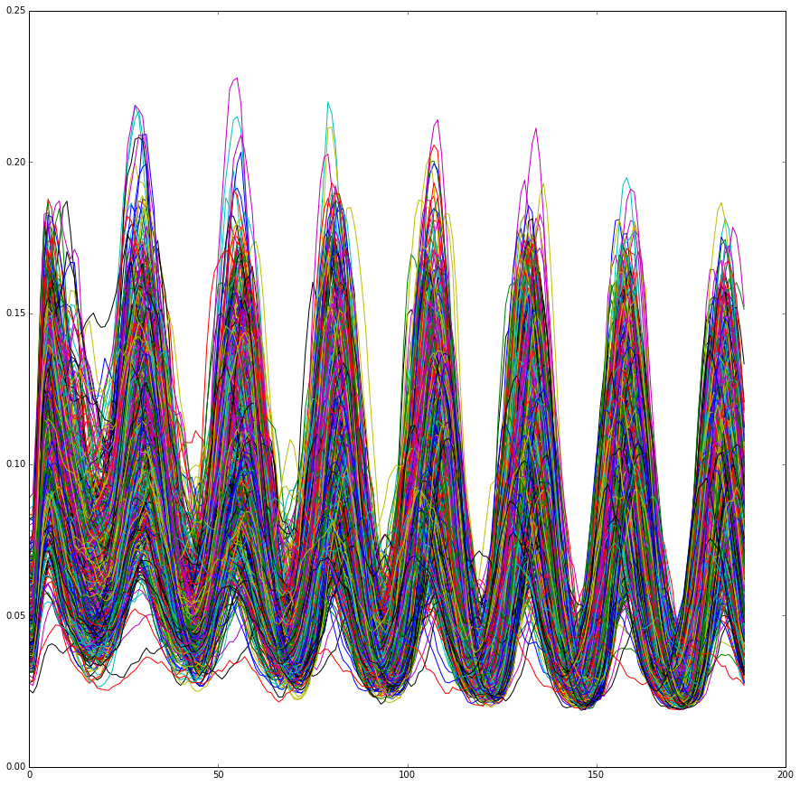
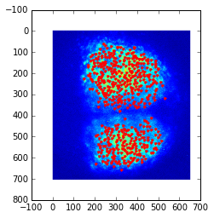
Default Output
541 cells tracked
Notes:
Signal intensity is measured from a single pixel of the filtered image and track through the movie; the data is normalized
Red location marker shown in right is the mean position of the neuron

Slide 9
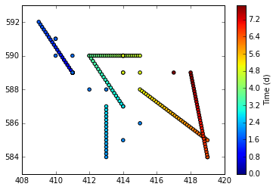
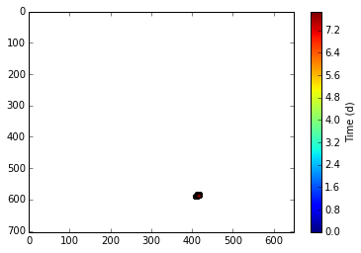
Showing How Individual “Cell” Moves

Slide 10
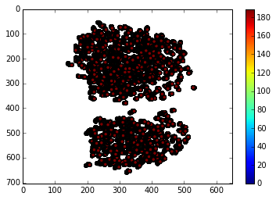

Slide 11
Downstream Applications
Run extract_data_supp.py to export ROI coordinates and time series data as .csv files
Visualization and manipulation (Matlab)
Rhythmicity
Chronostar (cosine fit)
Clocklab (Chi-sq)
Etc.
Synchrony
Circular statistics (R, Oriana)
Sync index (Matlab)

Slide 12
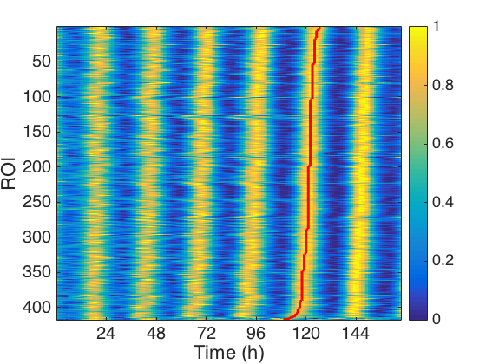
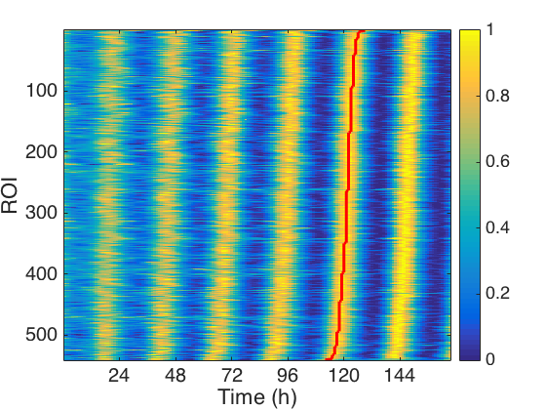
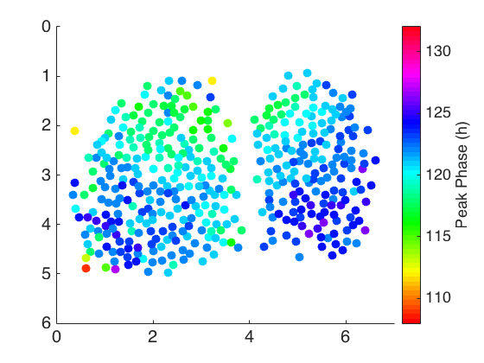
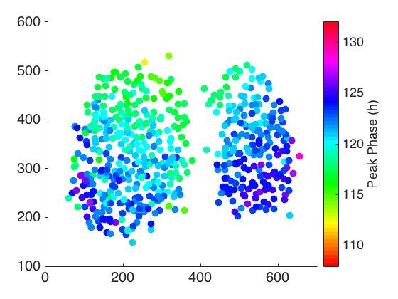
Neuron Tracker (n =541)
ROI (n = 417)

Slide 13
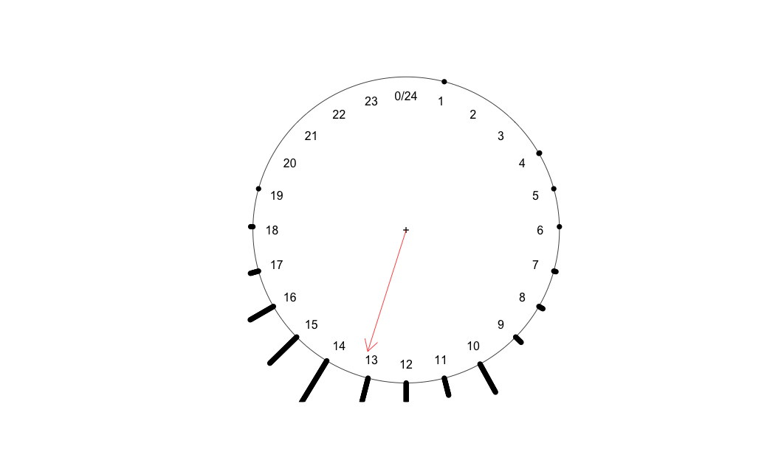
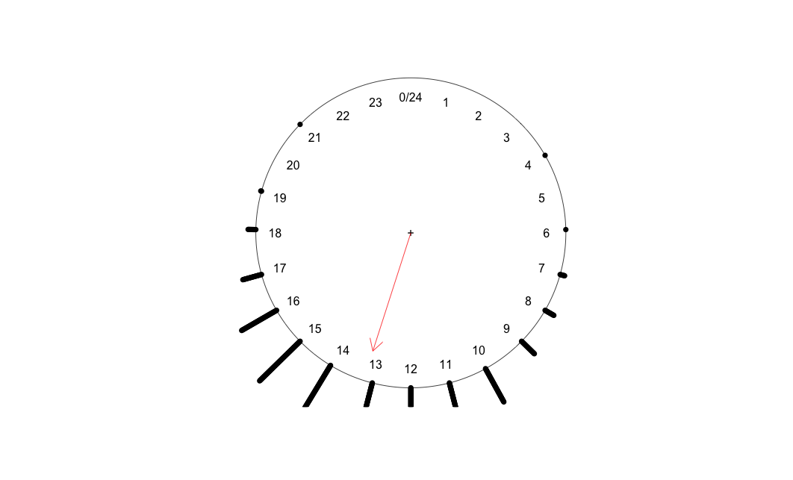
Comparing Synchrony by R(Circular)
ROI (n = 417)
Tracker (n = 541)
R - Circular
Mean peak phase = 121.17h
Rho = 0.832
R - Circular
Mean peak phase = 121.19h
Rho = 0.801

Slide 14
Comparing Rhythms in Individual Particles by Chronostar
ROI:
Tau = 25.52 ± .02 h
CC = 0.960 ± 0.001
Tracker:
Tau = 25.56 ± .02 h
CC = 0.962 ± 0.001

Slide 15
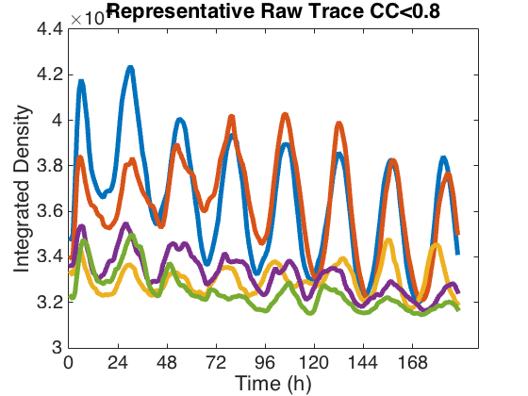
Multiple Cells within single ROI may lead to low CC values

Slide 16
All material covered and are now available in WUSTL Box!
Source code
Documentations
This Powerpoint
Sample data

Slide 17
Getting Started with Python
To run Python Scientific Programming Packages
install Anacoda (make sure it’s for python 2.7)
https://www.continuum.io/downloads
Launch Spyder
Open the extract_data.py in Spyder
Change line 71 to put in the file name
Run the code on iPython console
Note: the body of the code is line 332-355

Slide 18
Getting Start with Chronostar
Copy and paste the folder and run directly on any Windows machine

Slide 19
Getting Start with R
Download R studio
Click “Circular” in Package
Run and modify r_circular_example.r

Slide 20
Getting Start with Matlab
Run the code in Matlab with the following variables in input
Data
Each column is one trace
Column 1 is time
ROI
Col1 is x; col 2 is y
Note you need to flip y axis if roi is from imageJ

